Slide 1


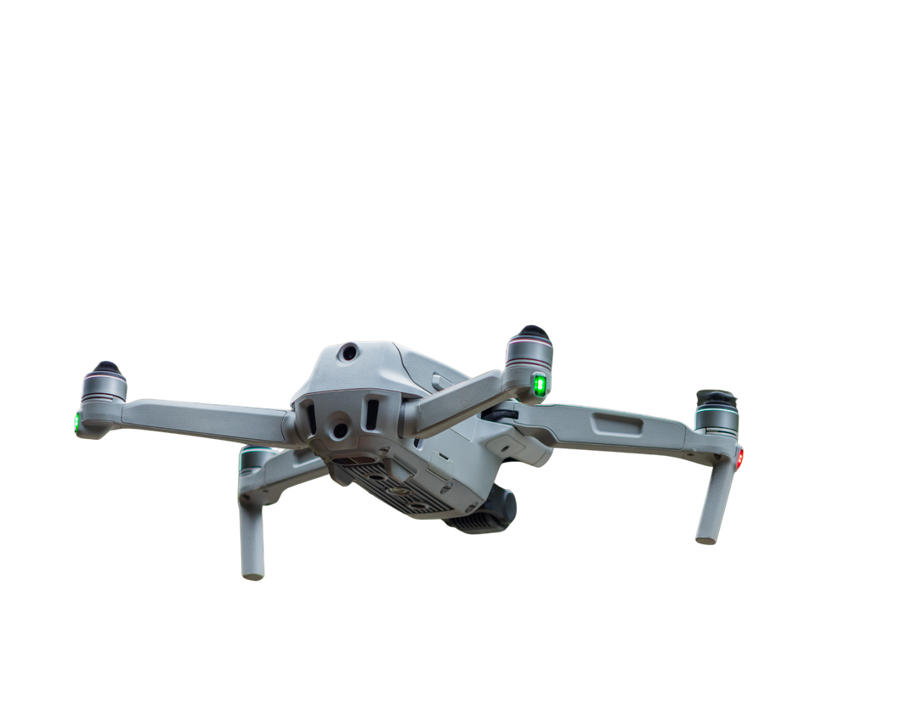
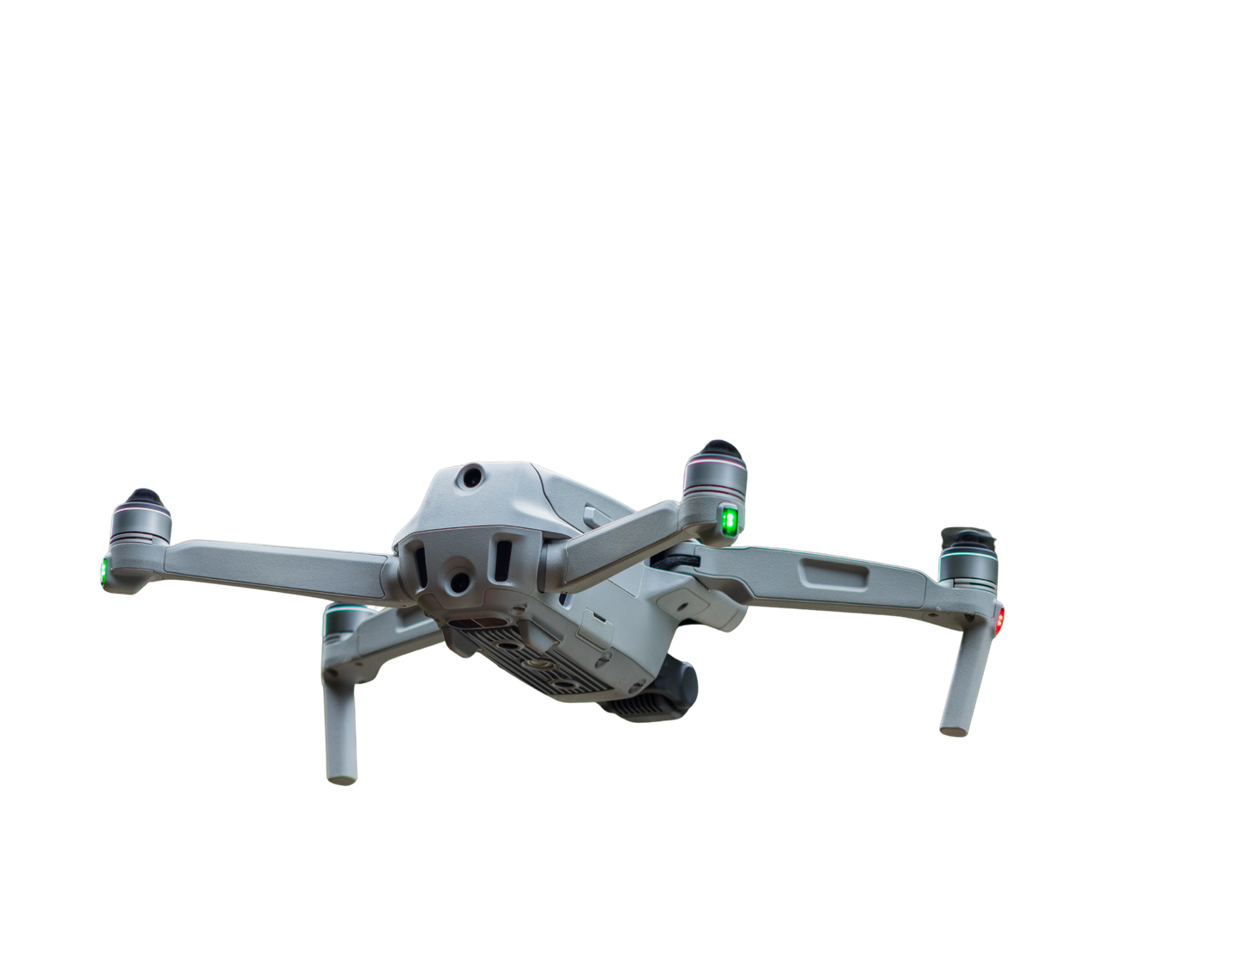
Coordinated Multi-UAV Exploration and Target Localization
An AI Framework for Autonomous Mapping of Unknown Environments
Adarsh
M.Sai Amirthesh

Slide 2

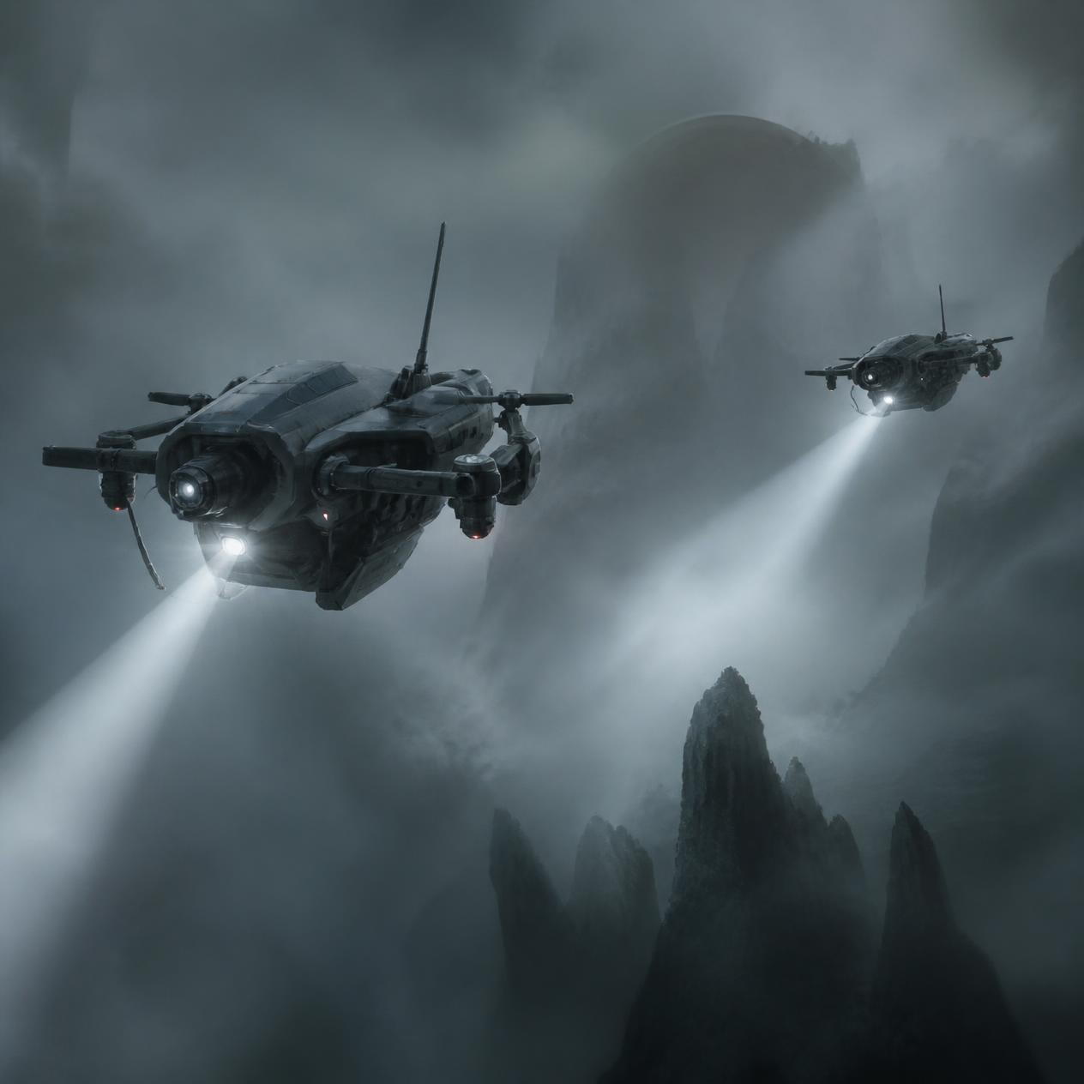

Why do we need Multi-UAV Systems?
The drones must:
  Explore the environment
  Avoid obstacles
  Build a map
  Detect important objects
  Share information with each other
This has applications in:
  Environmental Mapping
  Infrastructure Inspection
  Disaster Assessment
  Agriculture
  Industrial Inspection

Slide 3
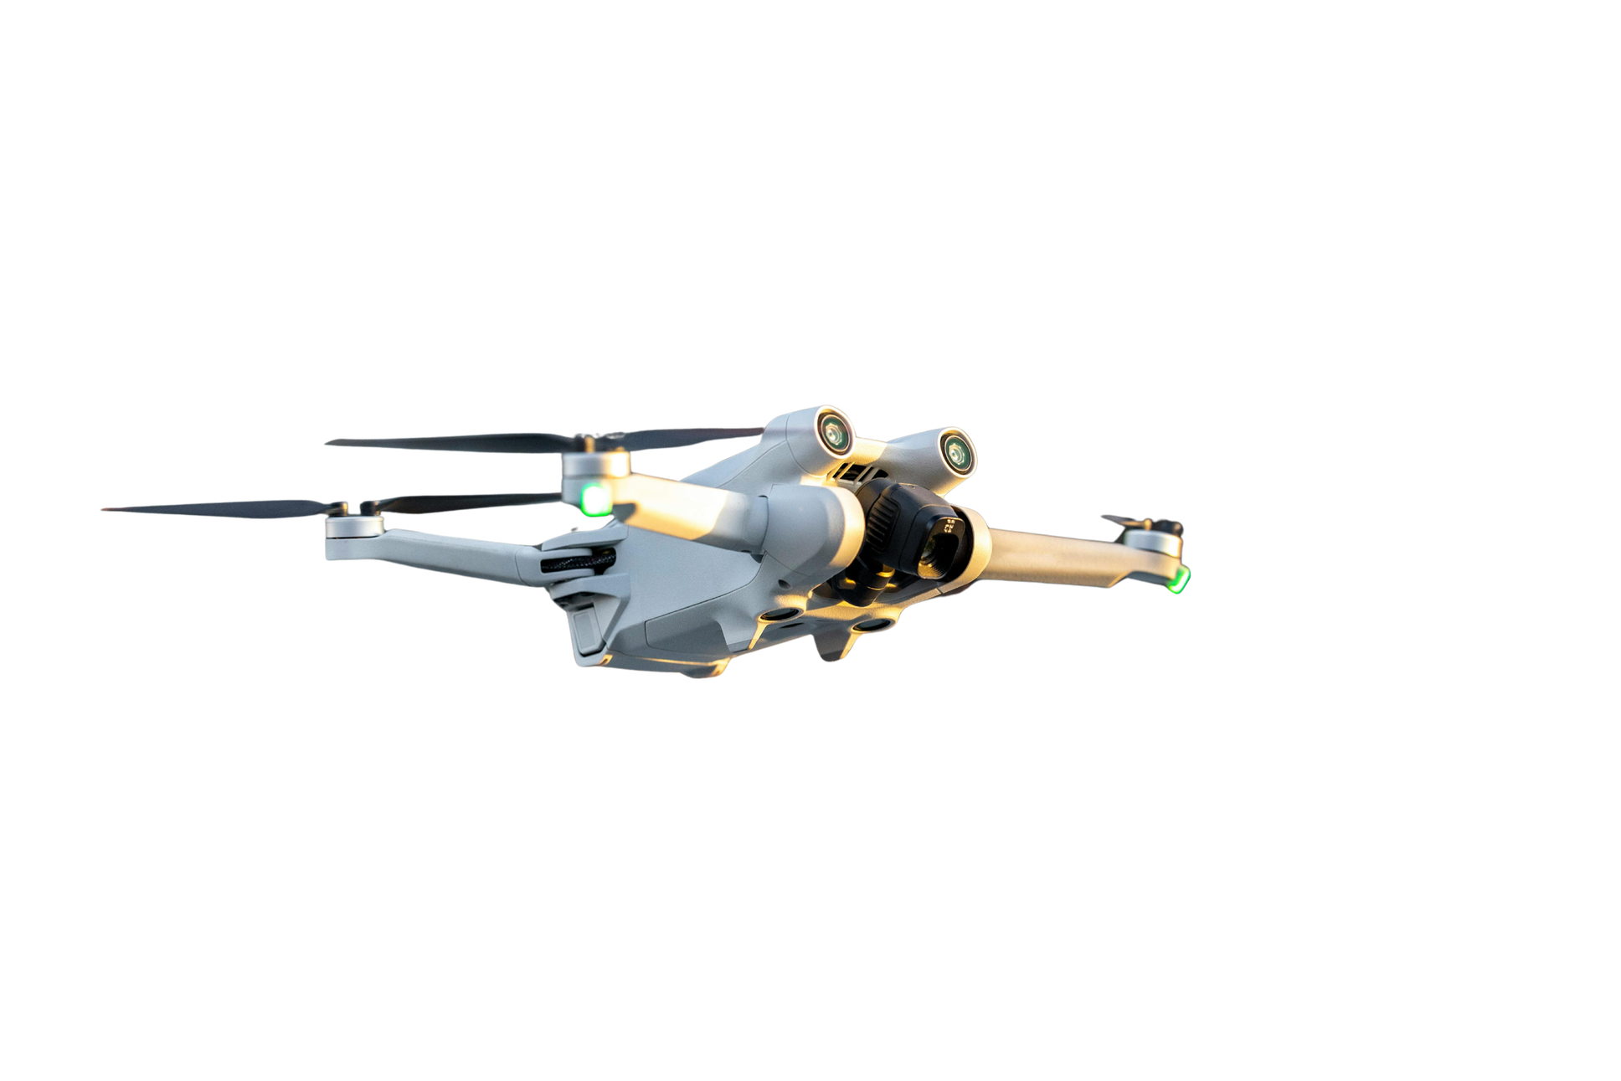

Problem Statement
Current multi-UAV systems face several challenges:
01.
Both UAVs may explore the same area.
Result
  Wasted flight time
  Redundant coverage
  Inefficient mapping
  Poor situational awareness
02.
Object detections are not linked to the generated map.
03.
Exploration and object detection work independently.
04.
Lack of efficient coordination between UAVs.

Slide 4


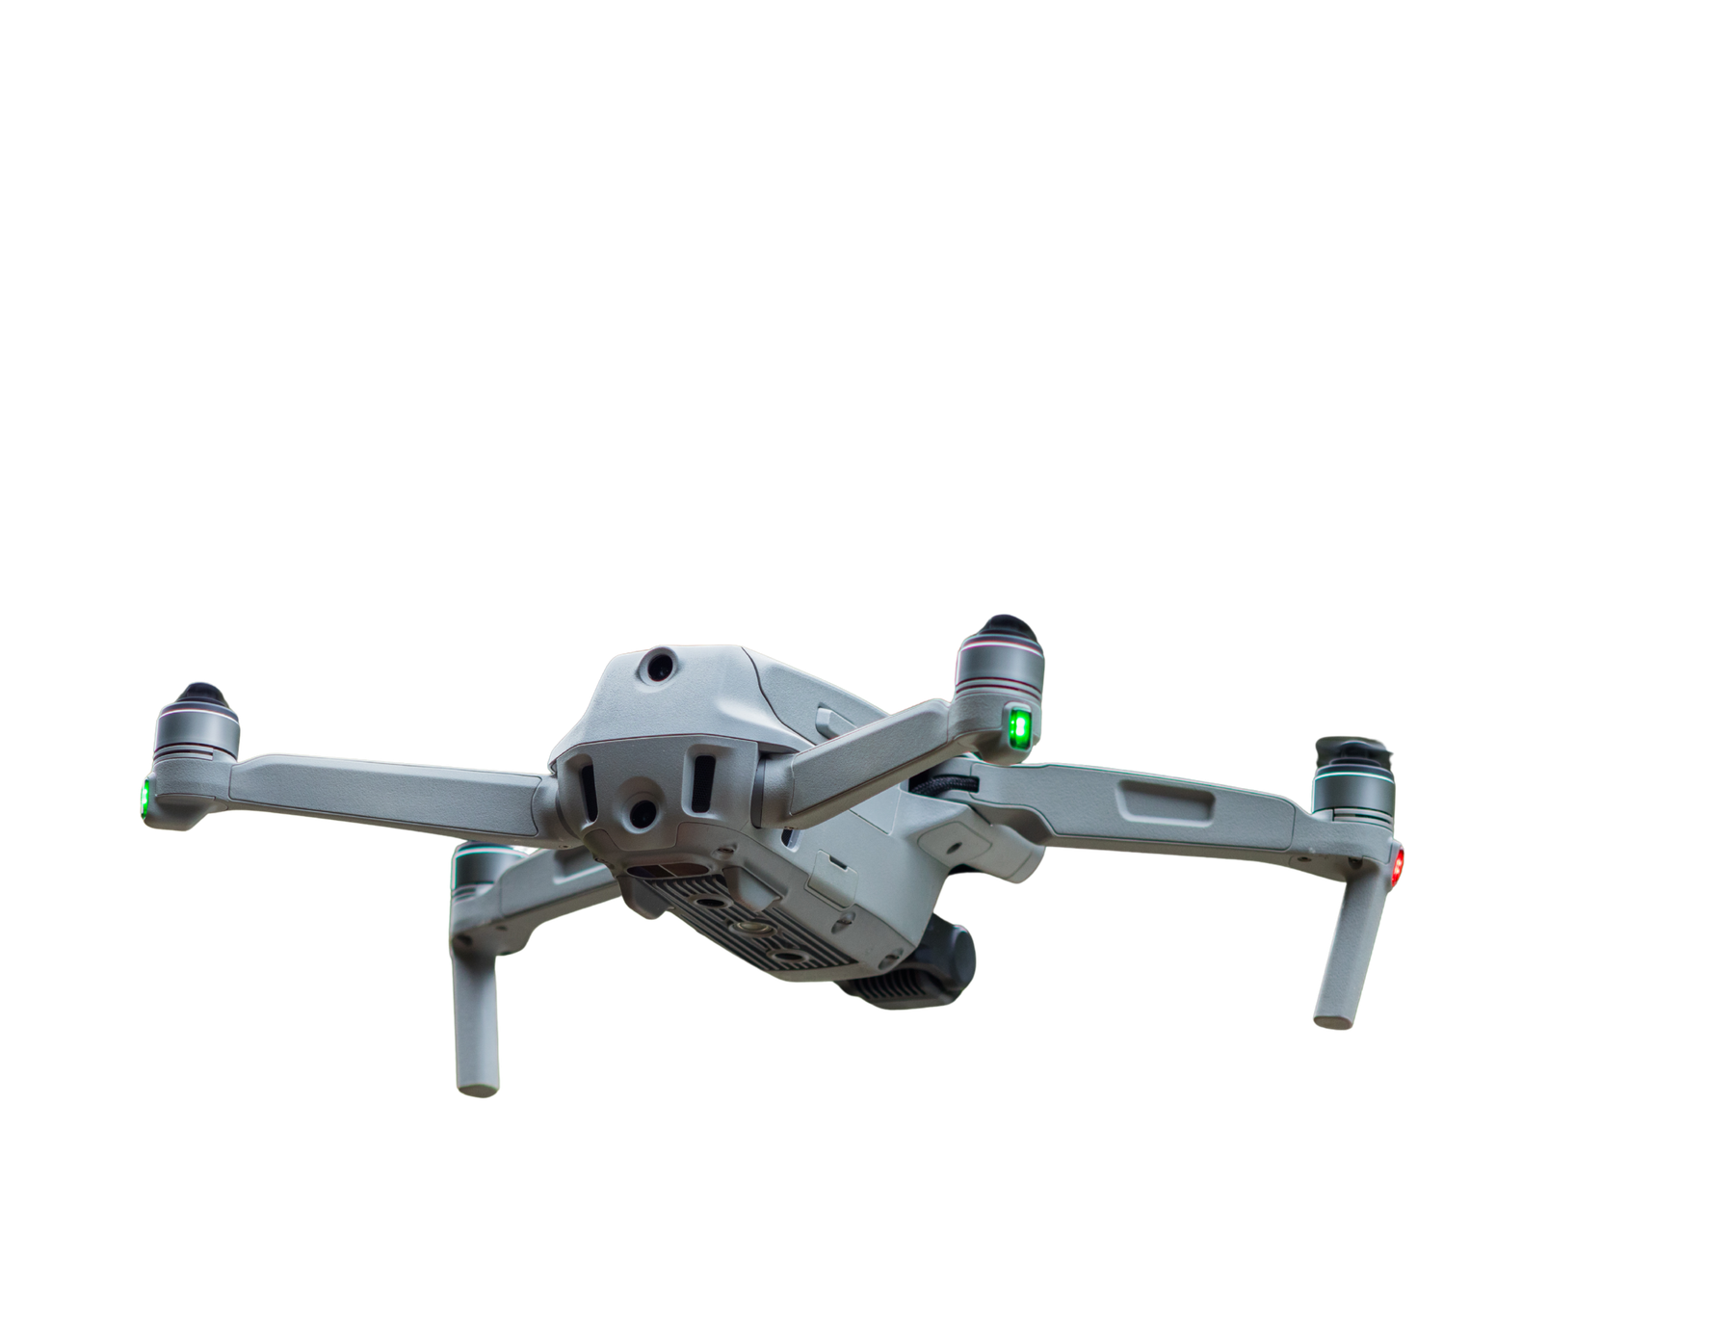
Research Gap
✔ Build maps
✖ Cannot localize detected objects.
Exploration Algorithms
✔ Detect objects
✖ Do not assist exploration.
Object Detection Systems
✔ Coordinate movement
✖ Lack integrated mapping and perception.
Multi-UAV Coordination

Slide 5

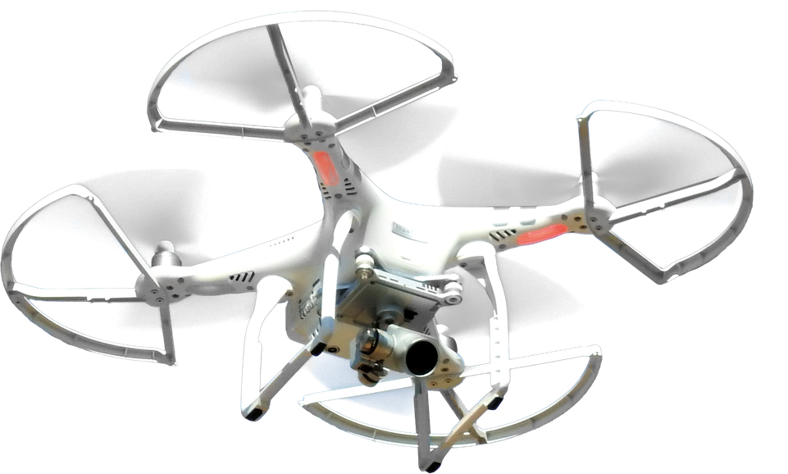
Our Proposed Framework
Utility-Driven Coordinated Multi-UAV Exploration System
that combines
  Autonomous Exploration
  Occupancy Mapping
  Utility-Based Frontier Allocation
  Online Target Localization
  Shared World Model
into a single pipeline.

Slide 6
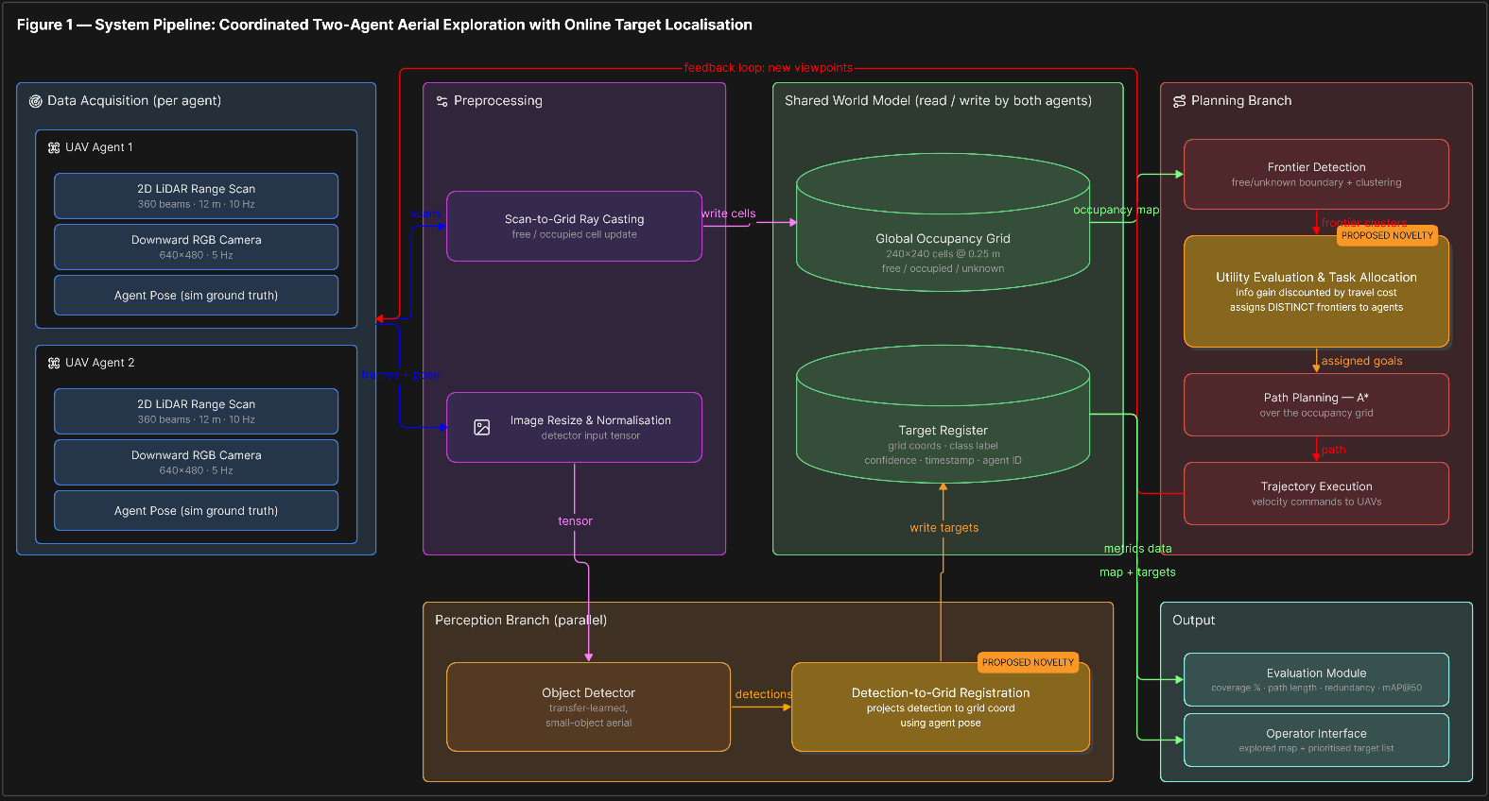
Overall Workflow

Slide 7
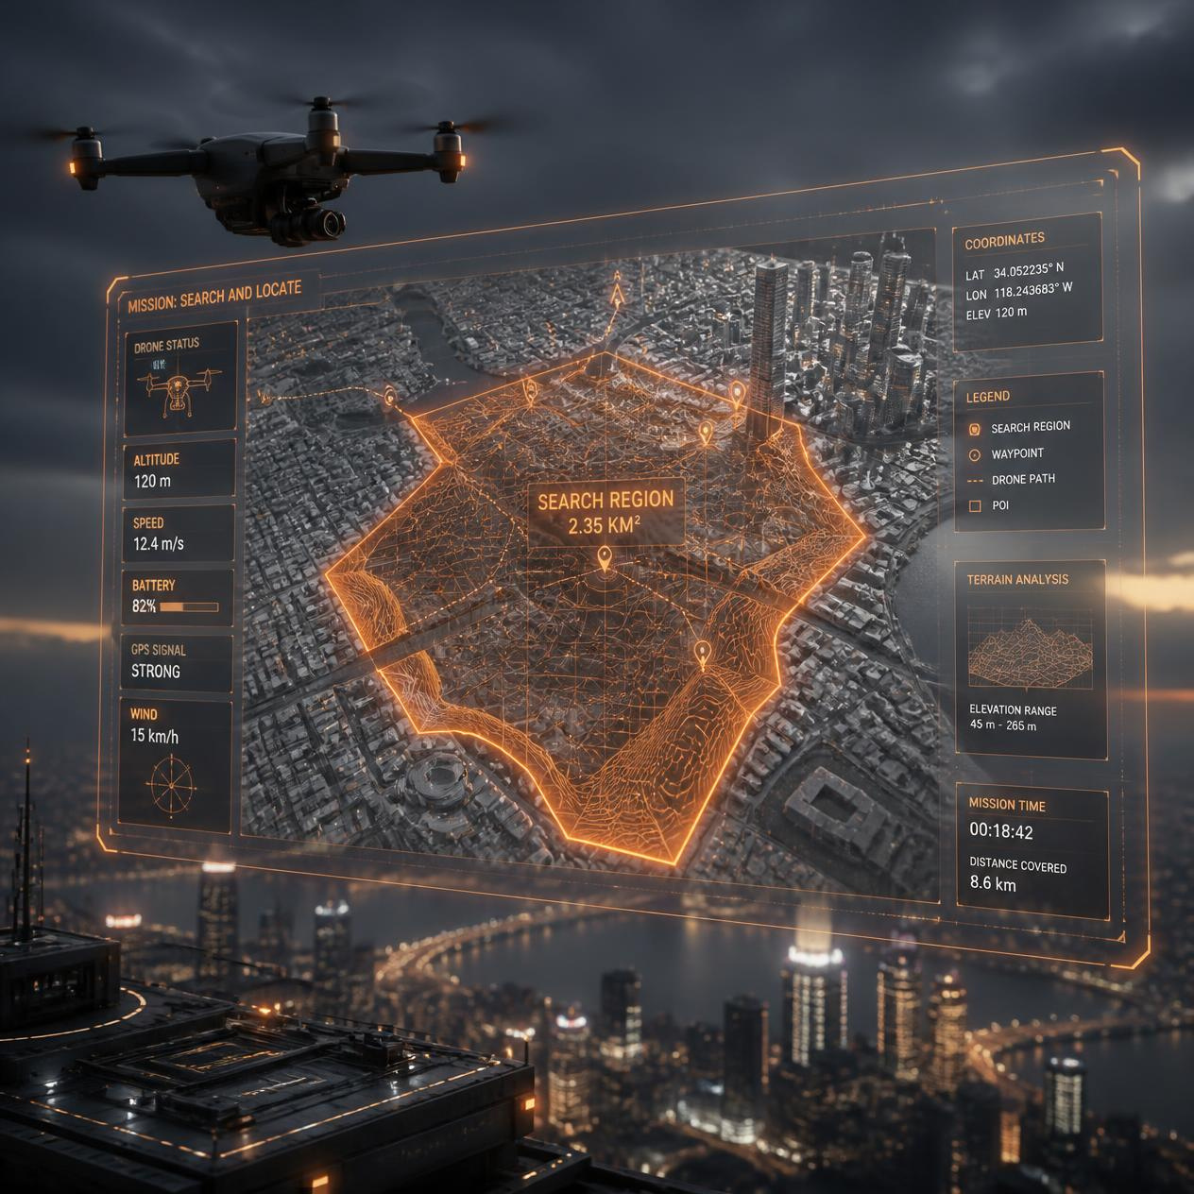

Overall Workflow
  UAV collects LiDAR and Camera data.
  Occupancy Grid is updated.
  Frontiers are identified.
  Utility function assigns exploration goals.
  Object detector identifies targets.
  Shared map is updated continuously.

Slide 8
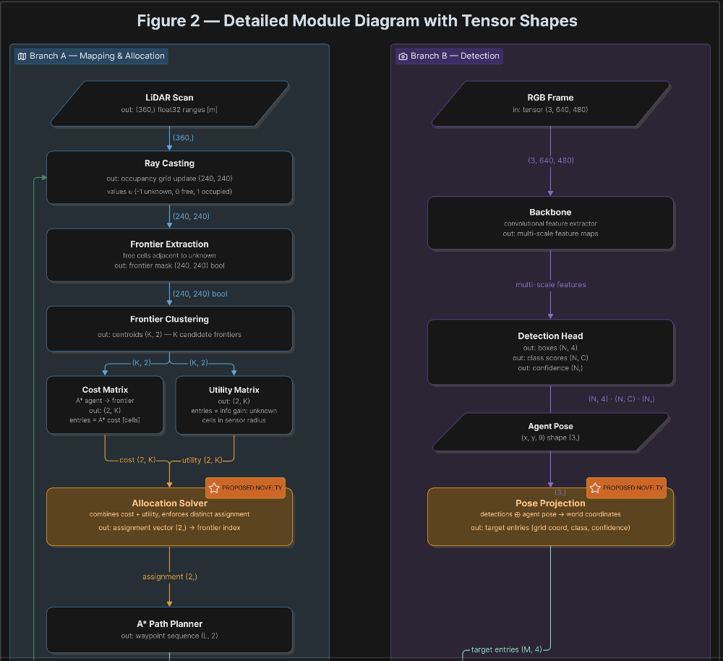
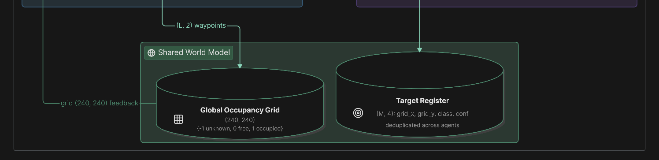
System Architecture
Divide into two branches.
  Mapping Branch
  Detection Branch
Both branches communicate through
Shared World Model

Slide 9
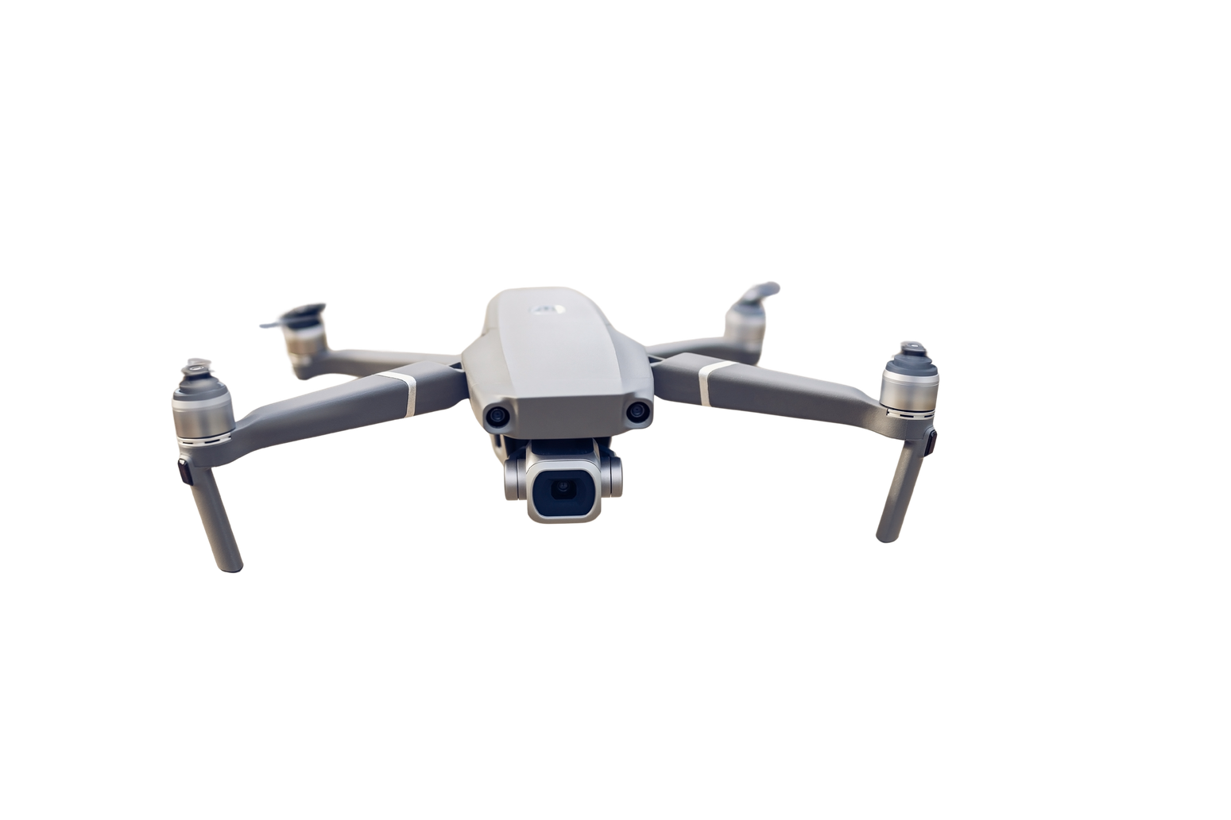

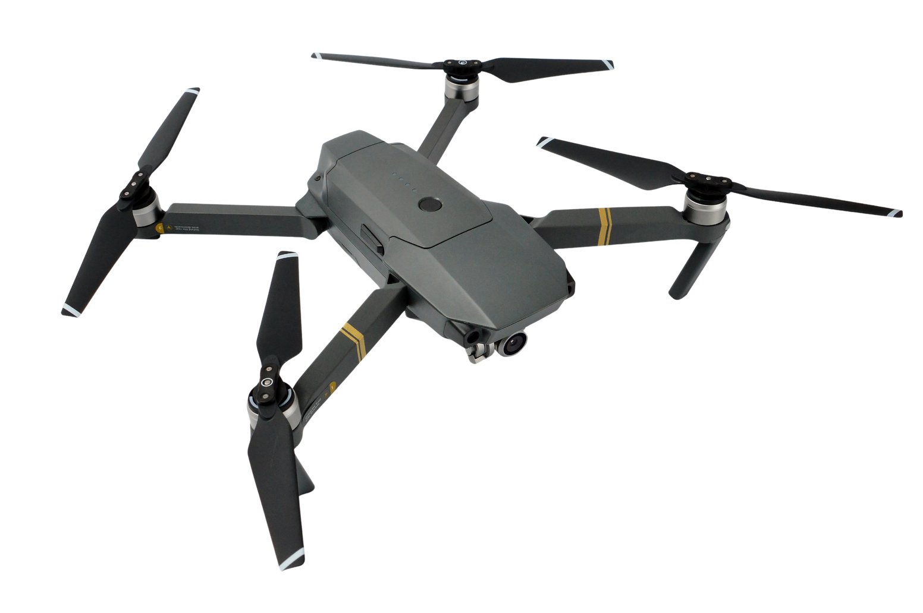
Technologies Used
Simulation
  Gazebo
Robotics
  ROS2
Programming
  Python
  C++
AI
  YOLO
  OpenCV
Navigation
  A*
Mapping
  Occupancy Grid

Slide 10

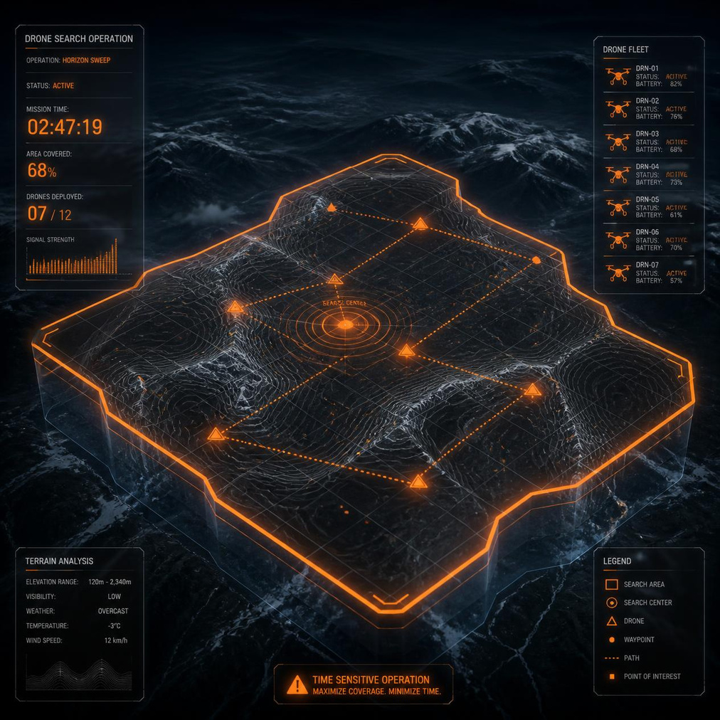
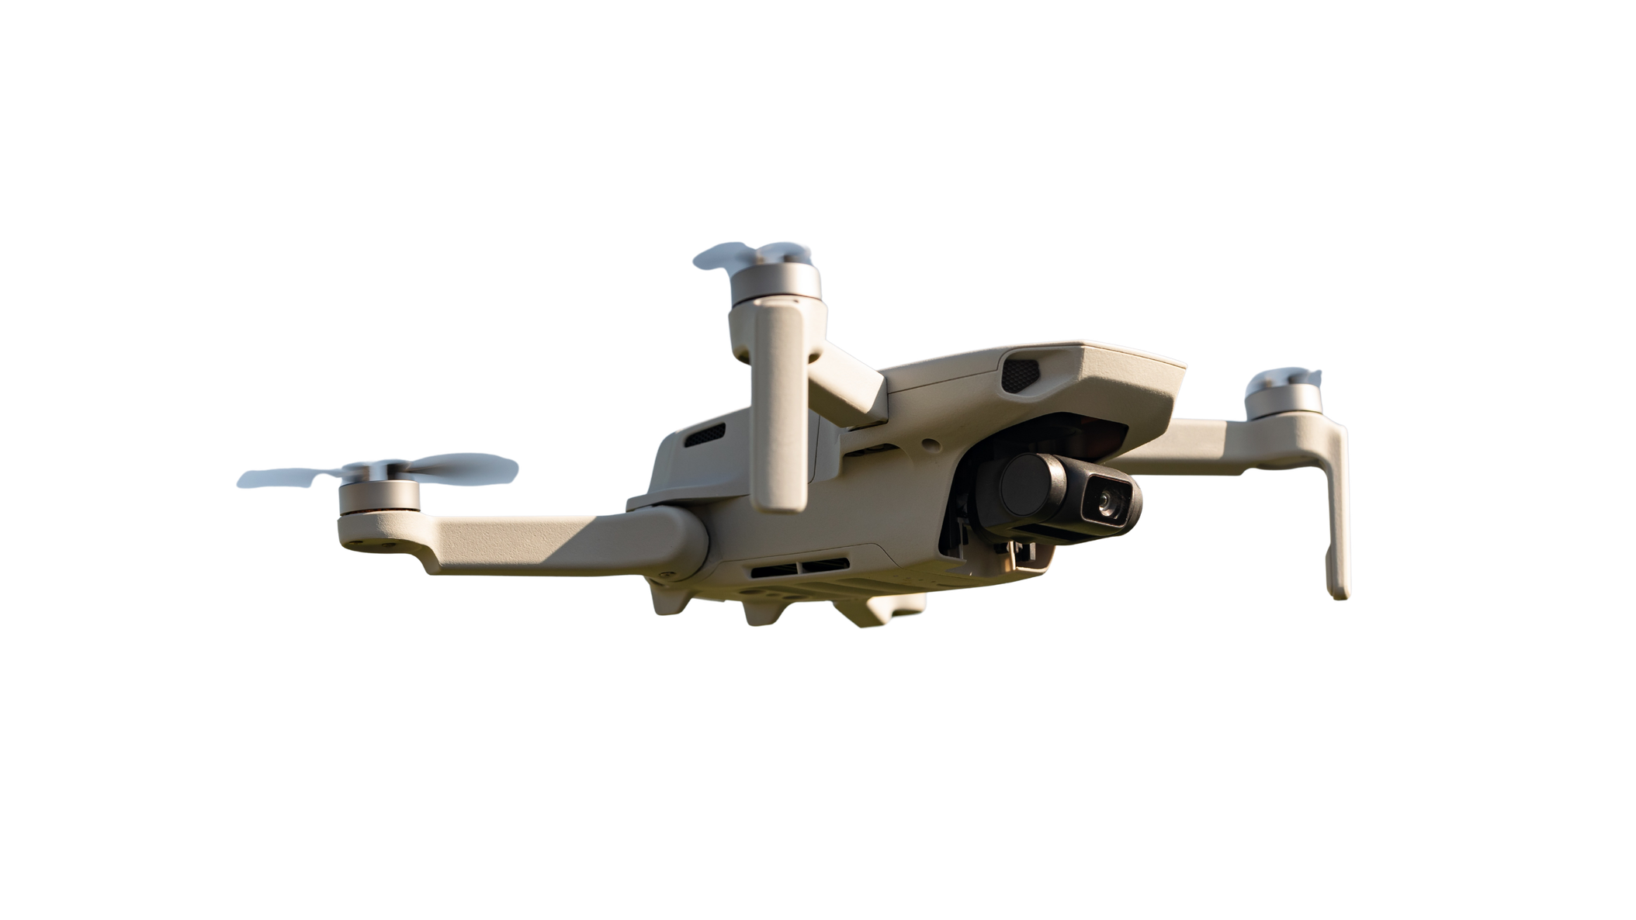
Expected Output
System should produce
✔ Occupancy Map
✔ Detected Targets
✔ Assigned Frontiers
✔ Planned Paths
✔ Shared World Model

